Slide 1
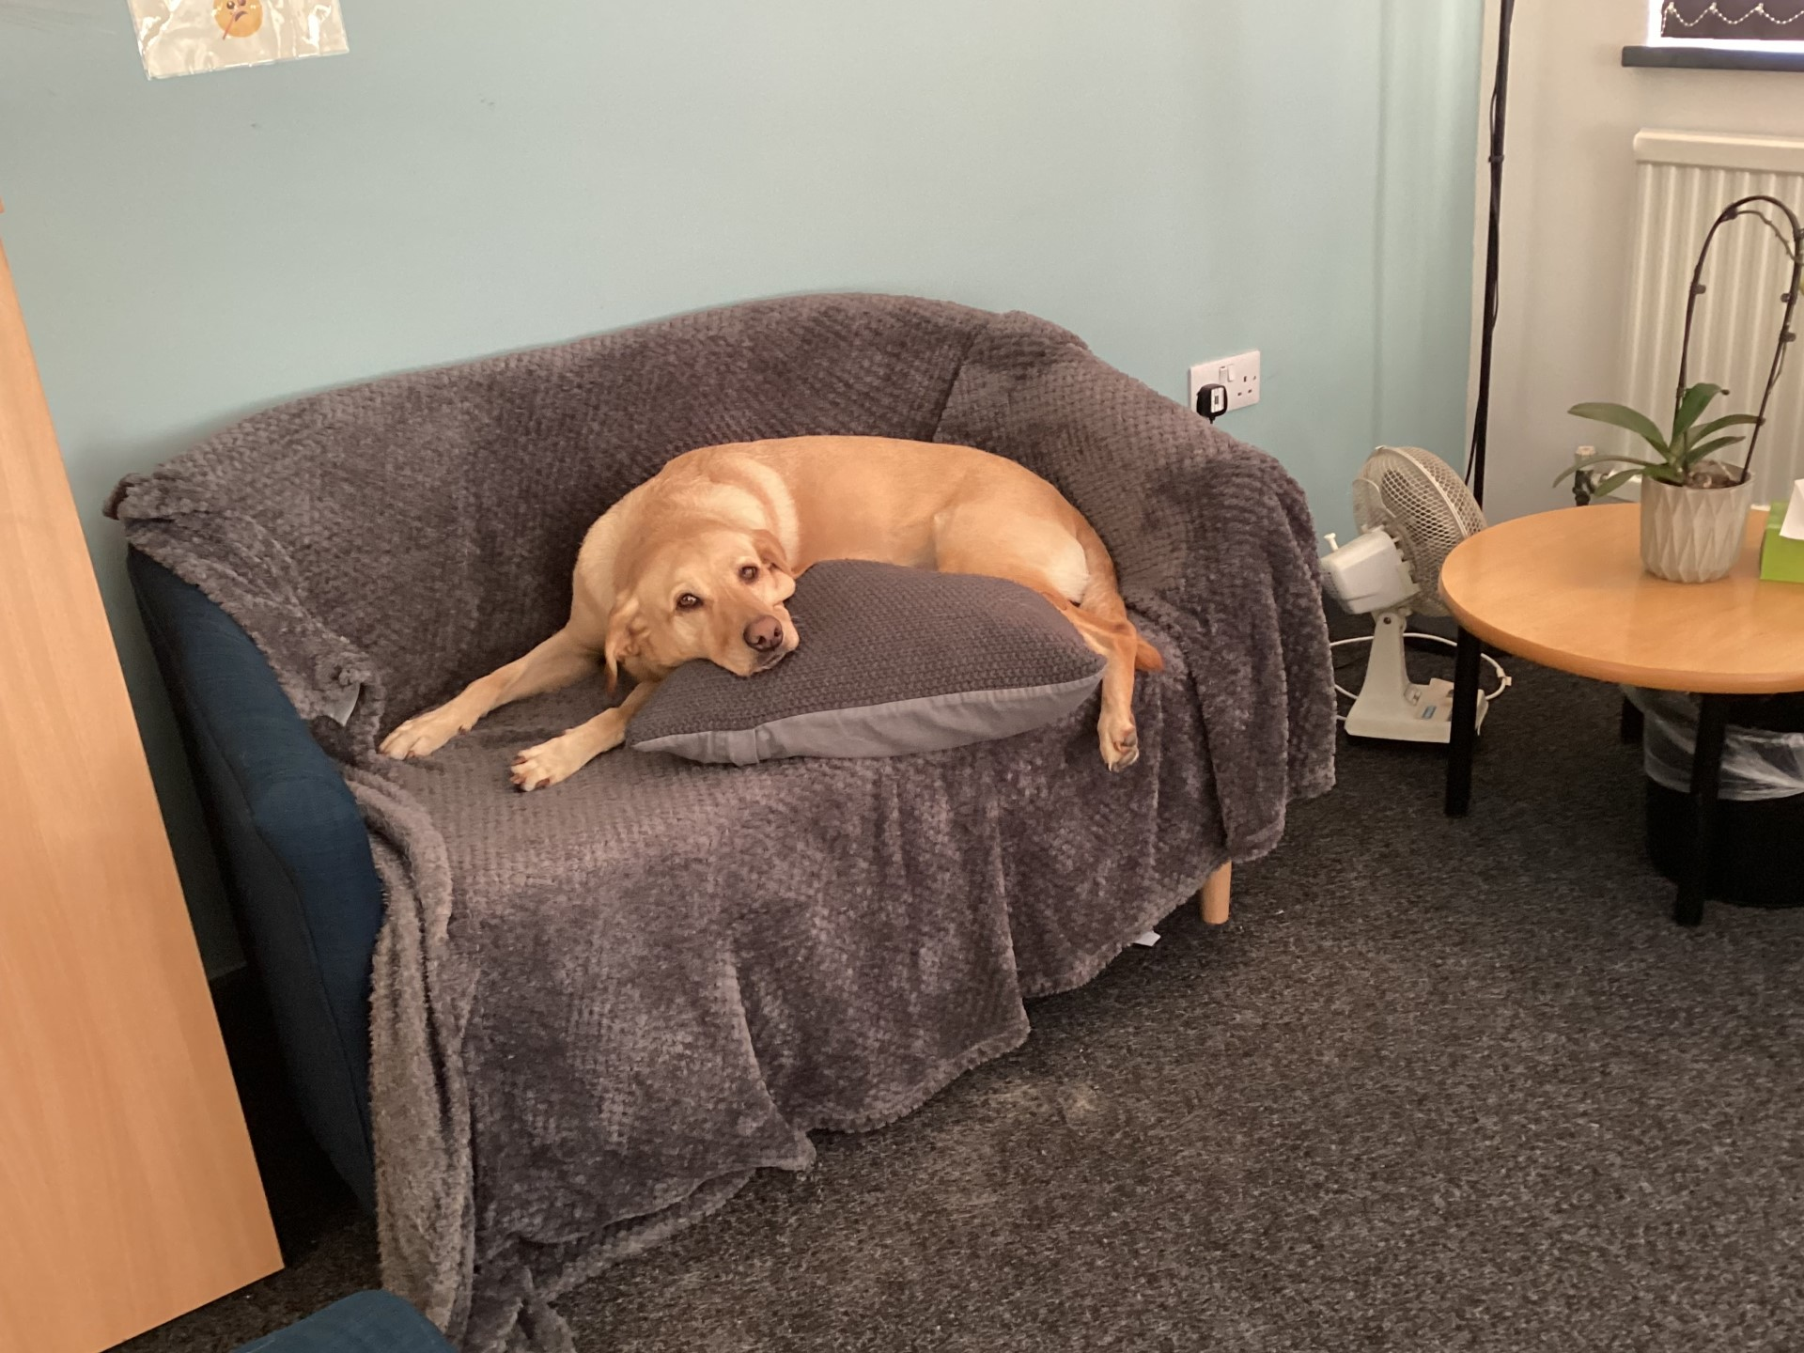
Bella the School Dog – Feedback from Students

Slide 2
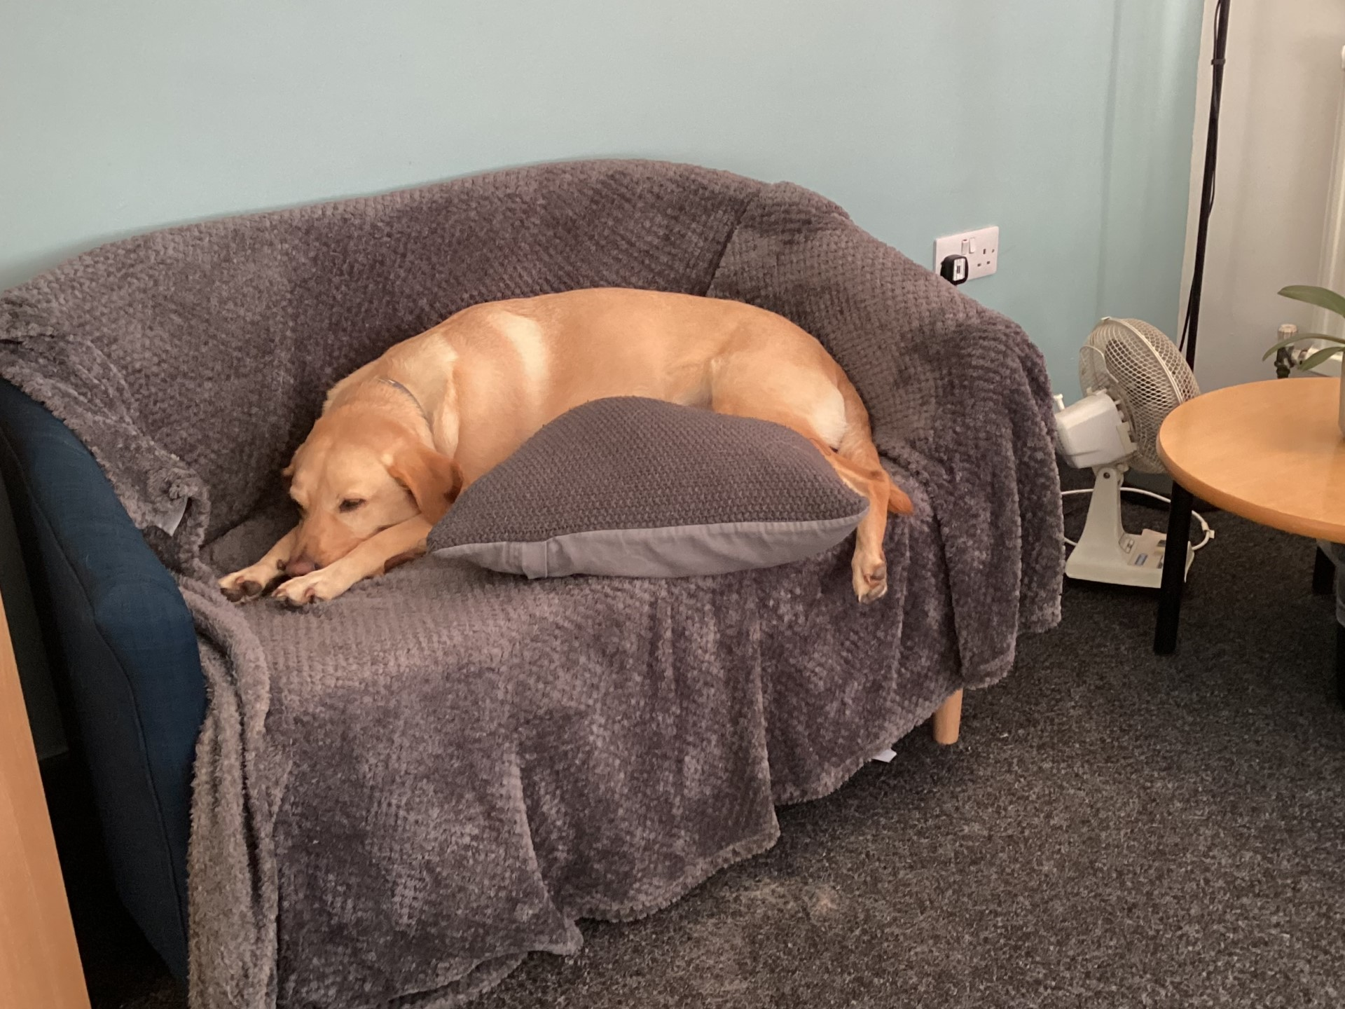
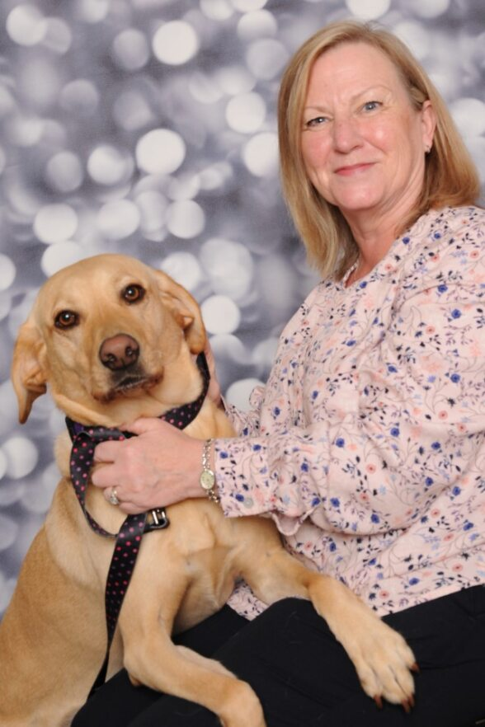
"How does Bella make you feel?"
"Happy and calm" - J
"Excited" - G
"Happy" - G
"Makes me feel calm" - A
"Green, happy and calm" - L

Slide 3
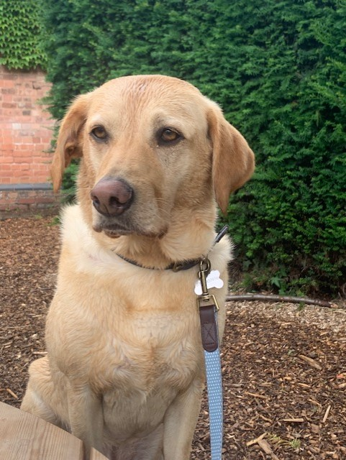
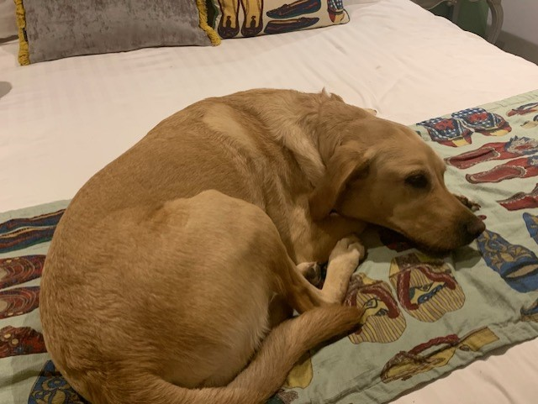
"Animals relax people" E
"I like Bella, because you can pet her " W
"Bella relaxes me she is so kind and calming, very well-behaved dog we love Bella" - S

Slide 4
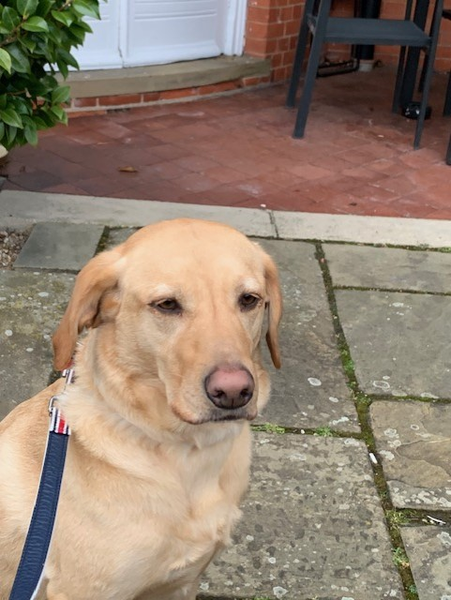
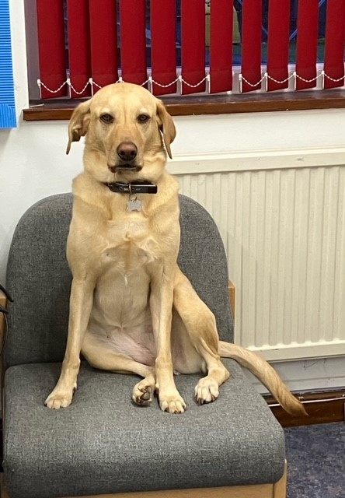
"Makes me feel green" - M
"Happy and calm" - S
"Motivated" - E
"Makes my day light up, makes me laugh" P

